Slide 1
CLARITY ONLY
THE REAL WORLD
CAN REVEAL
Commented clinical cases with
Doctor Azam Eghbal
START >

Slide 2
ELUCIREM™ (gadopiclenol) injection - Important Safety Information
WARNING: RISK ASSOCIATED WITH INTRATHECAL USE and NEPHROGENIC SYSTEMIC FIBROSIS (NSF)
Risk Associated with Intrathecal Use
  Intrathecal administration of gadolinium-based contrast agents (GBCAs) can cause serious adverse reactions including death, coma, encephalopathy, and seizures.
  ELUCIREM is not approved for intrathecal use.
Nephrogenic Systemic Fibrosis
  GBCAs increase the risk for NSF among patients with impaired elimination of the drugs. Avoid use of ELUCIREM in these patients unless the diagnostic information is essential and not available with non-contrasted MRI or other modalities. NSF may result in fatal or debilitating fibrosis affecting the skin, muscle and internal organs.
  The risk for NSF appears highest among patients with: Chronic, severe kidney disease (GFR <30 mL/min/1.73 m²) or Acute kidney injury. Screen patients for acute kidney injury and other conditions that may reduce renal function. For patients at highest risk for NSF, do not exceed the recommended ELUCIREM dose and allow a sufficient period of time for elimination of the drug prior to any re-administration.
Indications and Usage
  ELUCIREM™ (gadopiclenol) injection is indicated in adult and pediatric patients, including term neonates for use with magnetic resonance imaging (MRI) to detect and visualize lesions with abnormal vascularity in the central nervous system (brain, spine, and associated tissues), and the body (head and neck, thorax, abdomen, pelvis, and musculoskeletal system).
Contraindications
  Contraindicated in patients with history of hypersensitivity reactions to ELUCIREM.
Warnings and Precautions (continued on next slide)
  Risk Associated with Intrathecal Use: Not approved for intrathecal use; can cause death, coma, encephalopathy, and seizures.
  Nephrogenic Systemic Fibrosis: Avoid use among patients with impaired elimination unless essential.
Please see full Prescribing Information, including Medication Guide. | Slide 1 of 2
ISI

Slide 3
ELUCIREM™ (gadopiclenol) injection - Important Safety Information (continued)
Warnings and Precautions (continued)
  Hypersensitivity Reactions: Before ELUCIREM administration, assess all patients for any history of a reaction to contrast media, bronchial asthma and/or allergic disorders.
  Gadolinium Retention: Gadolinium is retained in the body for months or years in several organs. Certain patients may be at higher risk - including those requiring multiple lifetime doses, pregnant and pediatric patients, and patients with inflammatory conditions. Minimize repetitive GBCA imaging studies when possible.
  Acute Kidney Injury: In patients with chronically reduced renal function, acute kidney injury requiring dialysis has occurred with GBCAs.
  Extravasation and Injection Site Reactions: Ensure catheter and venous patency before injection. Extravasation may result in tissue irritation.
  Interference with Visualization: As with any GBCA, ELUCIREM may impair visualization of lesions seen on non-contrast MRI.
Adverse Reactions
  In clinical trials, most frequent adverse reactions (>0.2% of patients) included: injection site pain, headache, nausea, injection site warmth, injection site coldness, dizziness, localized swelling and erythema.
  Postmarketing experience with ELUCIREM or other GBCAs: Acute pancreatitis, acute respiratory distress syndrome, pulmonary edema.
Use in Specific Populations
  Pregnancy: GBCAs cross the human placenta and result in fetal exposure.
  Lactation: No data on presence of ELUCIREM in human milk, effects on the breastfed infant, or effects on milk production.
  Pediatric Use: Safety and effectiveness established in pediatric patients including term neonates. Safety not established in preterm neonates.
  Geriatric Use: ELUCIREM is substantially excreted by the kidney; risk of adverse reactions may be greater in patients with impaired renal function.
  Renal Impairment: Avoid use of GBCAs in patients with renal impairment unless diagnostic information is essential and not available with non-contrast MRI or other modalities.
Report negative side effects to the FDA at www.fda.gov/medwatch or 1-800-FDA-1088. Please see the full Prescribing Information, including the Medication Guide, for additional important safety information. | Slide 2 of 2
ISI

Slide 4
Click to Navigate
ABOUT DR. AZAM EGHBAL
CASE 2
CASE 1
Elucirem™
This interactive experience is based on real-world pediatric MRI cases presented by Dr Azam Eghbal.
In this presentation, she will guide you step by step through two clinical cases, sharing her insights and interpretation
of the images enhanced with Elucirem™ (gadopiclenol) injection.

Slide 5
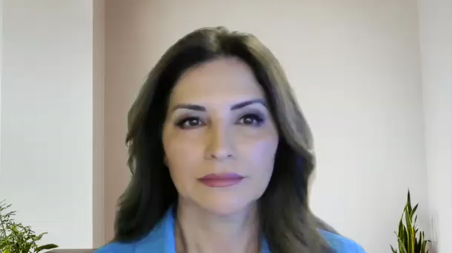
Dr. Eghbal is a paid consultant for Guerbet LLC.
ABOUT

Slide 6
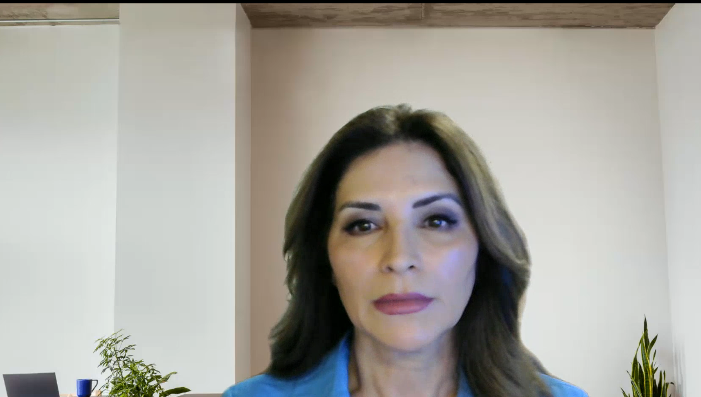
Case 1
Patient information
  Sex: Male
  Age: 8
Reason for exam
  Follow-up for pituitary enlargement and stalk thickening initially
Medical history
  Endocrine abnormality
Contrast enhancement
  GBCA: Elucirem™ (gadopiclenol)
  Gd dose: 0.05 mmol/kg body weight (BW)
MRI Scanner
  Magnetic field: 3T
Individual results may vary.
CASE 1

Slide 7
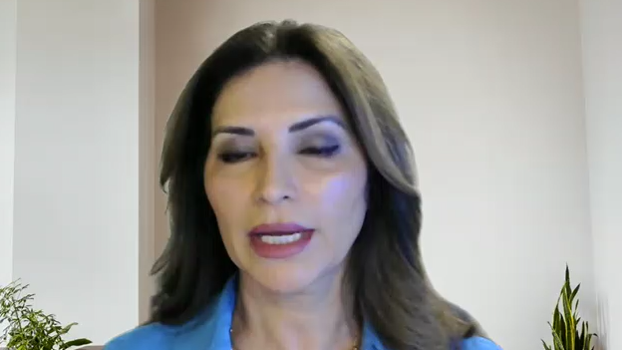
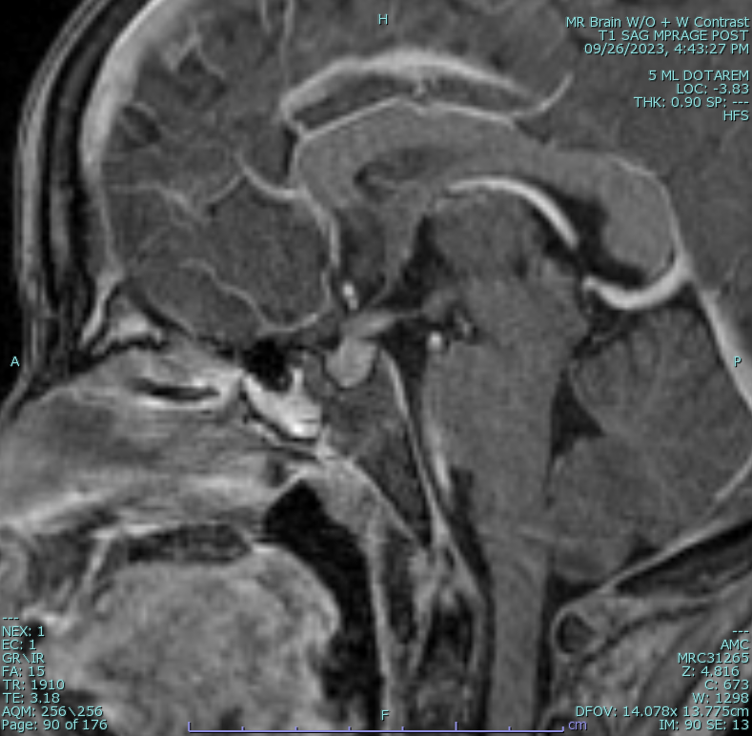
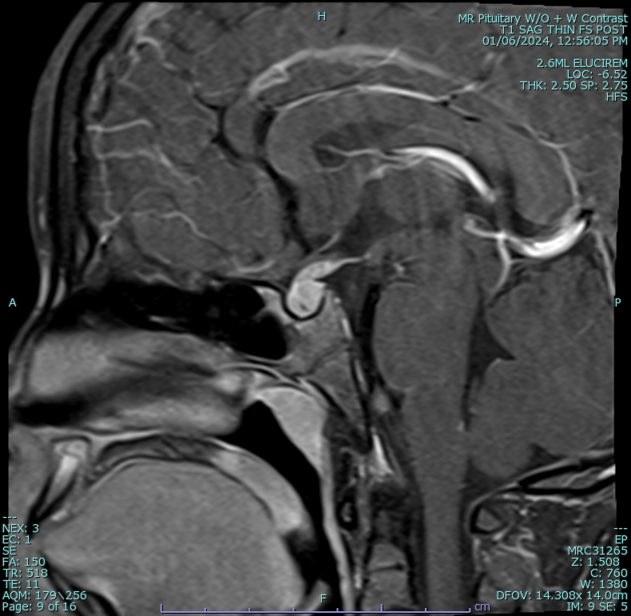
Sagittal post contrast images of the pituitary gland 3 months apart
Case 1
5 ml Dotarem® (gadoterate meglumine)
2.6 ml Elucirem™ (gadopiclenol)
CASE 1

Slide 8
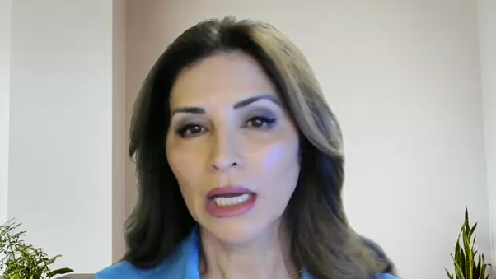
Dotarem® (gadoterate meglumine) injection vs. Elucirem™ (gadopiclenol) injection
Case 1
The images through the pituitary gland show abnormal thickening and enhancement of the pituitary stalk.
The degree of enhancement is still visible with Elucirem™ (gadopicleol) at half the dose of gadolinium compared
to Dotarem® (gadoterate meglumine). Due to abnormal enhancement, patient has biopsy which showed germinoma.
5 ml Dotarem®
2.6 ml Elucirem™
CASE 1

Slide 9
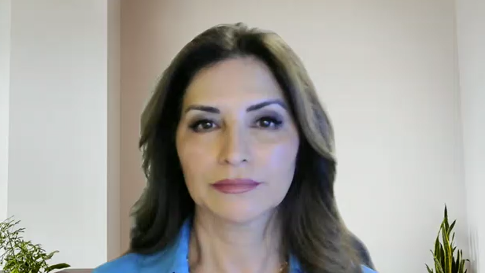
Case 2
Patient information
  Sex: Male
  Age: 6
Reason for exam:
  Acute mental status change and seizure
Medical history:
  Unvaccinated male tested positive for Measles
Contrast enhancement
  GBCA: Elucirem™ (gadopiclenol)
  Gd dose: 0.05 mmol/kg body weight (BW)
MRI Scanner
  Magnetic field: 3T
Individual results may vary.
CASE 2

Slide 10
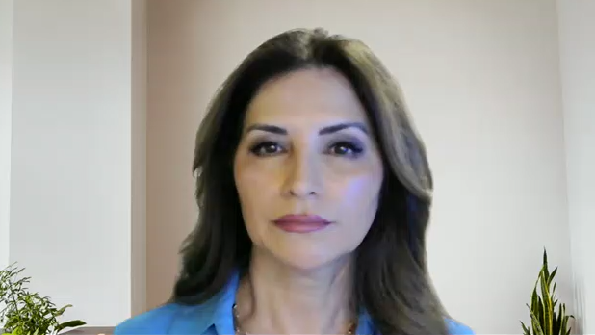
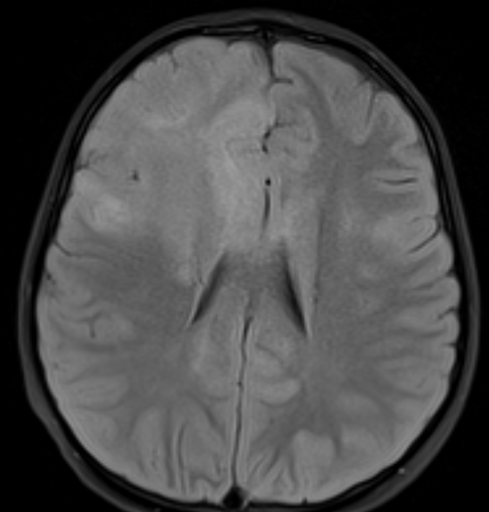
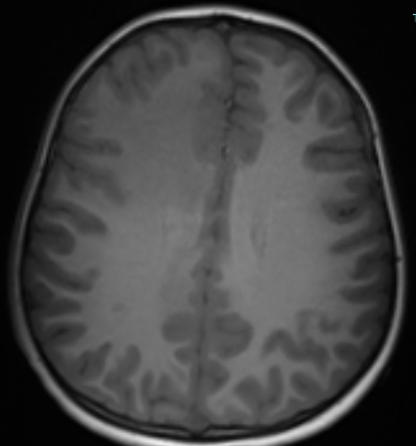
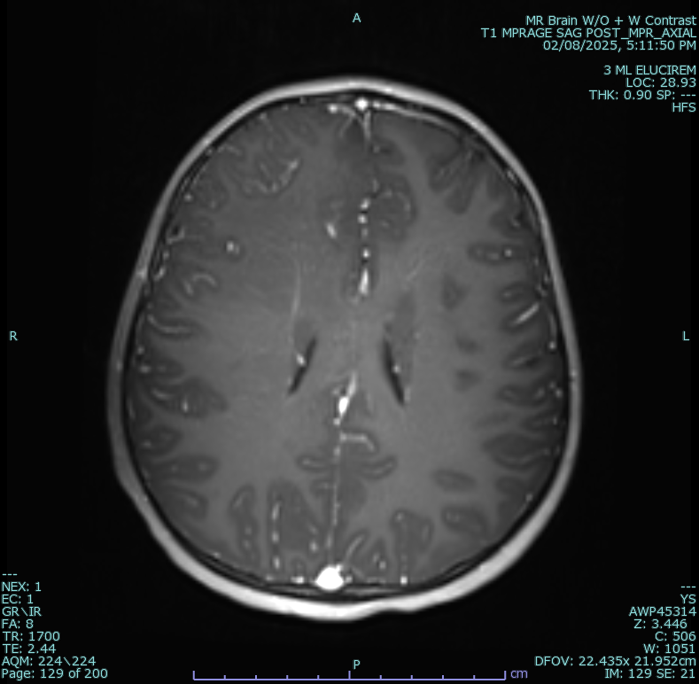
Axial Images of the Brain
Case 2
Axial FLAIR pre contrast
T1 axial pre contrast
T1 axial post contrast
3 ml Elucirem™ (gadopiclenol)
CASE 2

Slide 11
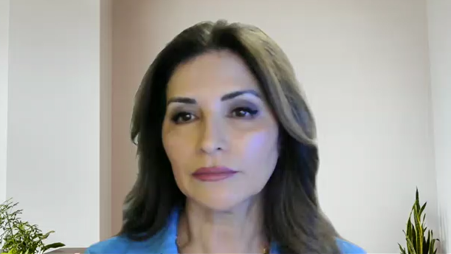
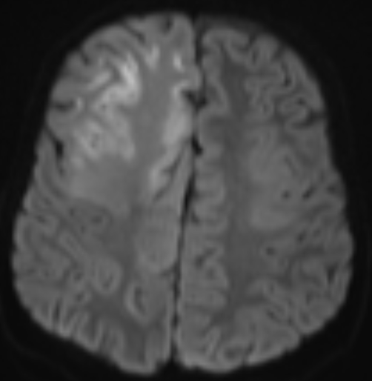
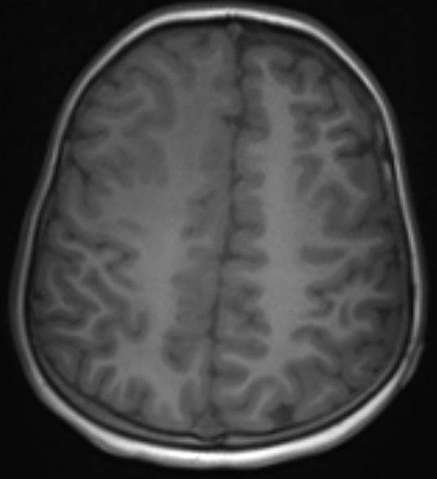
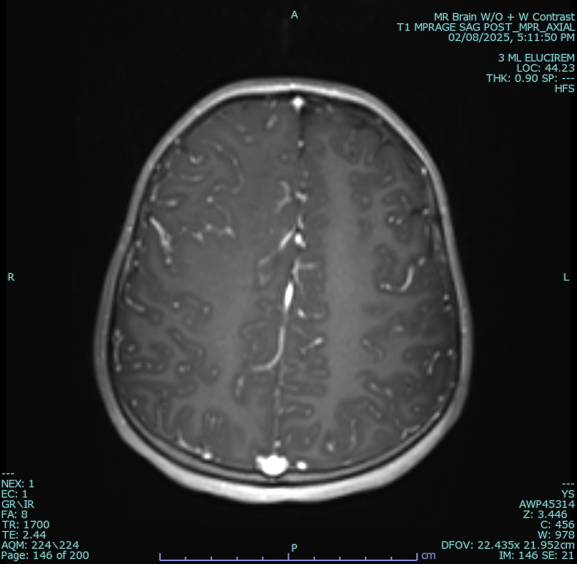
Axial Images of the Brain
Case 2
Axial DWI
T1 axial pre contrast
T1 axial post contrast
3 ml Elucirem™ (gadopiclenol)
CASE 2

Slide 12
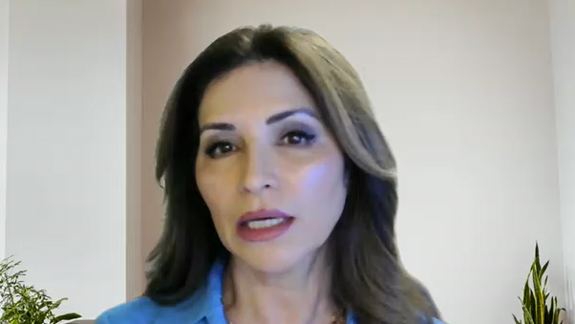
High relaxivity of Elucirem™
Case 2
Although subtle, there’s clear abnormal increased enhancement of the right frontal and parietal lobes
at the level of the cerebral edema. The high relaxivity
of Elucirem™(gadopiclenol) helps in making a diagnosis
at times when the enhancement is subtle or not lesional.
CASE 2

Slide 13
Elucirem™ (gadopiclenol):
Framing MRI in the real world since 2022
  High relaxivity designed to deliver high image clarity to achieve diagnostic confidence¹
  Requires only half the gadolinium dose compared to other approved GBCAs given at 0.1mmol/kg dose²
  Safety profile and efficacy well established in robust clinical trials,² reinforced by real world experience
  Used in routine MRI practice since 2022 across diverse patient populations - now indicated for pediatric patients 0-2 years old, including term neonates²
Approved for all ages
NEW INDICATION: 0 to 2 years¹
References
ELUCIREM™

Slide 14
Reference
  Robic C, Port M, Rousseaux O, et al. Physicochemical and Pharmacokinetic Profiles of Gadopiclenol:
  A New Macrocyclic Gadolinium Chelate With High T1 Relaxivity. Invest Radiol. 2019 Aug;54(8):475-484.
  Elucirem Prescribing Information. Guerbet; 2026.

Slide 15
DOTAREM® (gadoterate meglumine) injection - Important Safety Information
WARNING: RISK ASSOCIATED WITH INTRATHECAL USE and NEPHROGENIC SYSTEMIC FIBROSIS (NSF)
Risk Associated with Intrathecal Use
  Intrathecal administration of gadolinium-based contrast agents (GBCAs) can cause serious adverse reactions including death, coma, encephalopathy, and seizures.
  DOTAREM is not approved for intrathecal use.
Nephrogenic Systemic Fibrosis
  GBCAs increase the risk for NSF among patients with impaired elimination of the drugs. Avoid use of DOTAREM in these patients unless the diagnostic information is essential and not available with non-contrasted MRI or other modalities. NSF may result in fatal or debilitating fibrosis affecting the skin, muscle and internal organs. The risk for NSF appears highest among patients with: Chronic, severe kidney disease (GFR <30 mL/min/1.73m²) or Acute kidney injury. Screen patients for acute kidney injury and other conditions that may reduce renal function. For patients at highest risk for NSF, do not exceed the recommended DOTAREM dose and allow a sufficient period of time for elimination of the drug prior to any re-administration.
Indications and Usage
  DOTAREM® (gadoterate meglumine) injection is a prescription gadolinium-based contrast agent indicated for intravenous use with MRI in brain (intracranial), spine and associated tissues in adult and pediatric patients (including term neonates) to detect and visualize areas with disruption of the blood brain barrier (BBB) and/or abnormal vascularity.
Contraindications
  History of clinically important hypersensitivity reactions to DOTAREM.
Warnings and Precautions (continued on next slide)
  Risk Associated with Intrathecal Use: Not approved for intrathecal use; can cause death, coma, encephalopathy, and seizures.
  Nephrogenic Systemic Fibrosis: Avoid use among patients with impaired elimination unless essential.
Please see full Prescribing Information, including Medication Guide. | Slide 1 of 2
ISI

Slide 16
DOTAREM® (gadoterate meglumine) injection - Important Safety Information (continued)
Warnings and Precautions (continued)
  Hypersensitivity Reactions: Anaphylactic and anaphylactoid reactions have been reported with DOTAREM, involving cardiovascular, respiratory, and/or cutaneous manifestations. Some patients experienced circulatory collapse and died. Before DOTAREM administration, assess all patients for any history of a reaction to contrast media, bronchial asthma
  and/or allergic disorders.
  Gadolinium Retention: Gadolinium is retained for months or years in several organs. The highest concentrations have been identified in bone, followed by other organs (e.g. brain, skin, kidney, liver and spleen). While clinical consequences of gadolinium retention have not been established in patients with normal renal function, certain patients might be at higher risk - including those requiring multiple lifetime doses, pregnant and pediatric patients, and patients with inflammatory conditions. Minimize repetitive GBCA imaging studies when possible.
  Acute Kidney Injury: In patients with chronically reduced renal function, acute kidney injury requiring dialysis has occurred with GBCAs. The risk may increase with increasing dose; administer the lowest dose necessary for adequate imaging.
  Extravasation and Injection Site Reactions: Ensure catheter and venous patency before injection. Extravasation may result in tissue irritation.
Adverse Reactions
  In clinical trials, most frequent adverse reactions (>0.2% of patients) included: nausea, headache, injection site pain, injection site coldness and rash.
  Serious adverse reactions in postmarketing experience include but are not limited to: arrhythmia, cardiac arrest, respiratory arrest, pharyngeal edema, laryngospasm, bronchospasm, coma, convulsion, acute pancreatitis, acute respiratory distress syndrome, pulmonary edema.
Use in Specific Populations
  Pregnancy: GBCAs cross the human placenta and result in fetal exposure and gadolinium retention. Use only if imaging is essential during pregnancy and cannot be delayed.
  Lactation: No data on the presence of gadoterate in human milk, the effects on the breastfed infant, or the effects on milk production.
  Pediatric Use: Safety and effectiveness established in pediatric patients including term neonates. Safety not established in preterm neonates.
  Geriatric Use: DOTAREM is substantially excreted by the kidney; risk of adverse reactions may be greater in patients with impaired renal function.
  Renal Impairment: Avoid use of GBCAs in patients with renal impairment unless diagnostic information is essential and not available with non-contrast MRI or other modalities.
Report negative side effects to the FDA at www.fda.gov/medwatch or 1-800-FDA-1088. Please see the full Prescribing Information, including the Medication Guide, for additional important safety information. | Slide 2 of 2
ISI

